Slide 1
Ch.26 Testing Mobile Applications

Slide 2
26.1 Mobile App Testing Strategy Questions
Do you have to build a fully functional prototype before you test with users?
Should you test with the user’s device or provide a device for testing?
What devices and user groups should you include in testing?
When is lab testing versus remote testing appropriate?

Slide 3
26.2 Mobile Testing Guidelines
Understand the network landscape and device landscape.
Conduct testing in uncontrolled real-world test conditions.
Select the right automation test tool.
Identify the most critical hardware/ platform combinations to test.
Check the end-to-end functional flow in all possible platforms at least once.
Conduct performance, GUI, and compatibility testing using actual devices.
Measure MobileApp performance under realistic network load conditions.

Slide 4
26.3 Mobile App Testing
Conceptual Testing
Unit and System Testing
User Experience Testing
Stability Testing
Connectivity Testing
Performance Testing
Compatibility Testing
Security Testing
Certification Testing

Slide 5
26.4 Automated Testing
Feasibility analysis
Proof of concept
Best practice test framework
Customize testing tools
Test under real world conditions
Rapid defect resolution
Reuse of test scripts

Slide 6
26.5 Stress Test Cases
Running several mobile apps on the same device
Infecting system software with viruses or malware
Attempting to take over a device and use it to spread spam
Force the mobile app to process inordinately large numbers of transactions
Storing large amounts of data on the device

Slide 7
26.6 Mobile Usability Elements
Functionality
Information architecture
Screen Design
User input mechanisms
Mobile context taken into account
Interface usability
Trustworthiness
Feedback
Help facilities

Slide 8
26.7.1 Specialized Usability Tests
Gestures
Voice input and recognition
Virtual keyboard input
Alerts and errors
Case Study

Slide 9

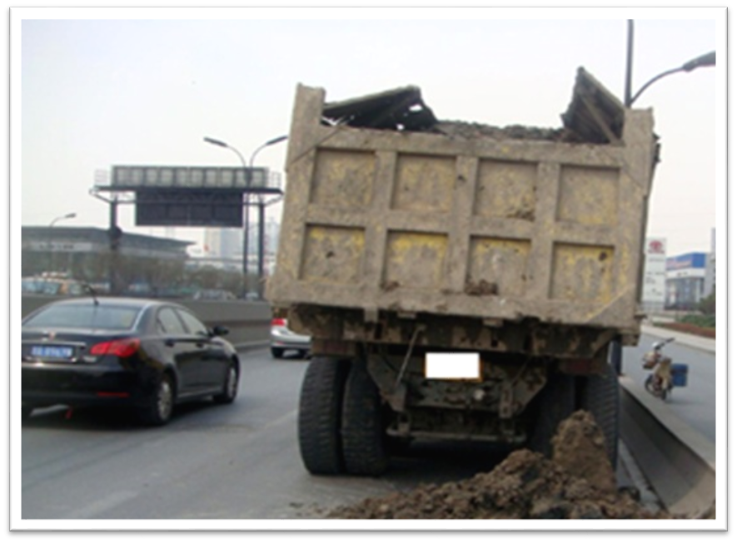

案卷拍拍 记录查询
1
现场抓拍
2
现场微信
12:30 20’’
12:31 10’’
上报提示
当前案卷已成功上报，案卷号： 201300432289。
确 认
拍照
按住说话
确认上报

Slide 10
26.7.2 “现场抓拍”测试用例要点
能否成功调用摄像头进行拍照？
能否成功调用麦克风发布语音消息？
语音消息过长（30秒以上）上传失败，是否有提示弹出？
语音消息过多（3条以上）上传失败，是否有提示弹出？
点击“确认上报”能否正确上报？上报成功后是否有提示？
遇到网络连接错误是否有警告？
上报成功后“记录查询”模块是否自动增加一条新的记录？

Slide 11
26.8.1 Mobile App Testing Tools
Mobile page compliance checkers
Mobile browser emulators
Device emulators
Key logging and playback
Network monitors
Mobile analytics collectors

Slide 12
26.8.2 Tool Sample:某在线测试云平台
云测试：一键提交，多设备多系统全自动测试服务
安装卸载测试：检测安装/卸载APP是否能正常完成
遍历测试：遍历APP所有控件，并记录崩溃现象和操作路径。
UI适配测试：判断APP是否完美匹配所有屏幕尺寸
稳定性测试：对APP进行压力测试
云调试远程可视化调试，快速定位并调试
    提供百余种真机测试机和模拟器
    降低开发成本
    针对某款测试机单独安装APP，对操作过程进行日志跟踪，远程可视化调试
在线测试云平台
    百度移动云测试中心：http://mtc.baidu.com/
    Testin 云测：http://www.testin.cn/

Slide 13
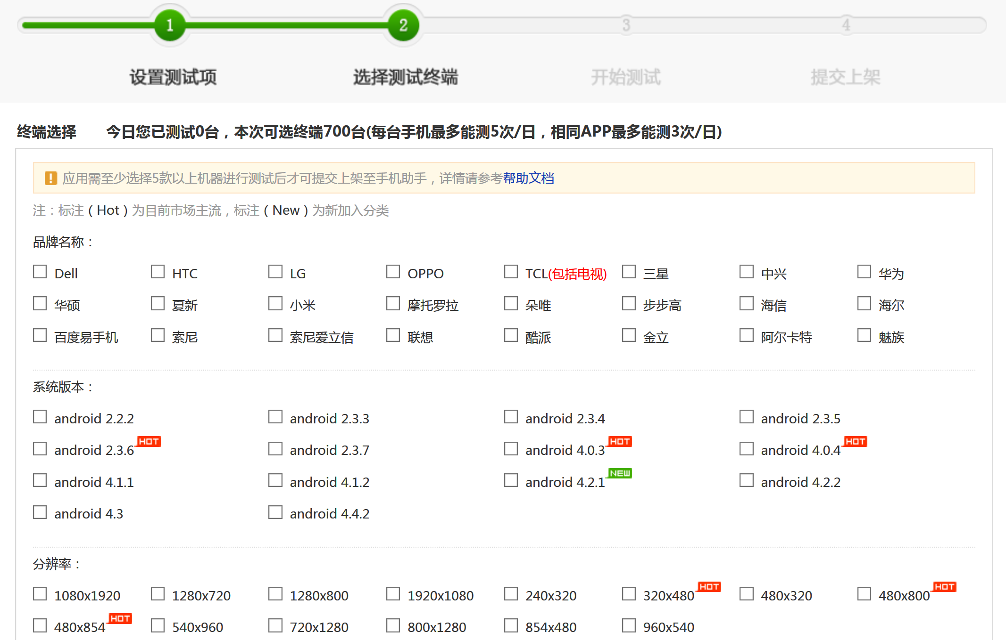
26.8.2 Tool Sample:某在线测试云平台

